Slide 1















PROG212 POE
Presented by Aaliyah Allie

Slide 2


INTRO
Welcome to my presentation where i will be demonstrating and explaining my final prog submissions for the semester.
The power point will go over my design choses, and overall functionality of my application.
There is also a video submission within my upload which will go more in depth on the features.

Slide 3
FOR THIS POE I USE WPF . NET FRAMEWORK TO OBTAIN APPLICATION DESIGN AND FUNCTIONALITY
01.
PROJECT DESCRIPTION
FOR THIS FINAL SUBMISSION WE ARE TASKED WITH ADDING IN AUTOMATION TO THE DIFFERENT USER VIEWS
02.
for this POE we were tasked with creating a claims submission system for Lecturers of an institution.
It is powered by lecturers submitting their claims and it being approved by coordinators. It also includes HR representatives who also have final say over submitted claims
AND FINALLY OUR PROGRAM MUST WORK IN RELATION TO A DATABASE
03.

Slide 4
DATABASE
FOR THIS POE THE DATABSE OF CHOICE WHICH I HAVE DECIDED TO MAKE USE OF IS SQL SERVER MANAGEMENT.
MY DATABASE HAS 3 TABLES (Account User Table, Claims Table and Supporting Documents Table).
All these work in relation to my application to allow it to fuction

Slide 5
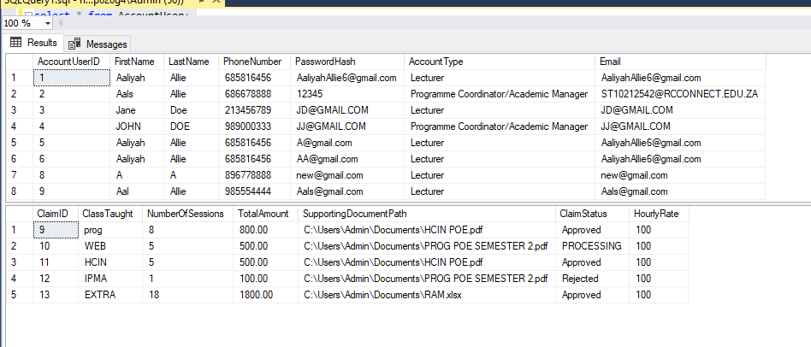
DATABASE

Slide 6
over all flow
My application contains an overall flow of the following:
CREATE ACCOUNT
LOGIN (LECTURER/PROGRAMME COORDINATOR)
LECTURER DASH
PROGRAM DASH
HR VIEW

Slide 7
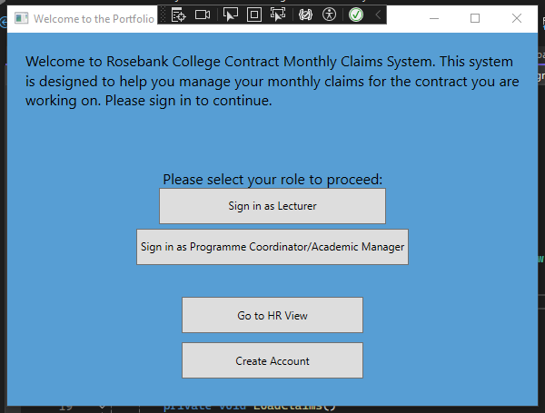
HOME PAGE

Slide 8
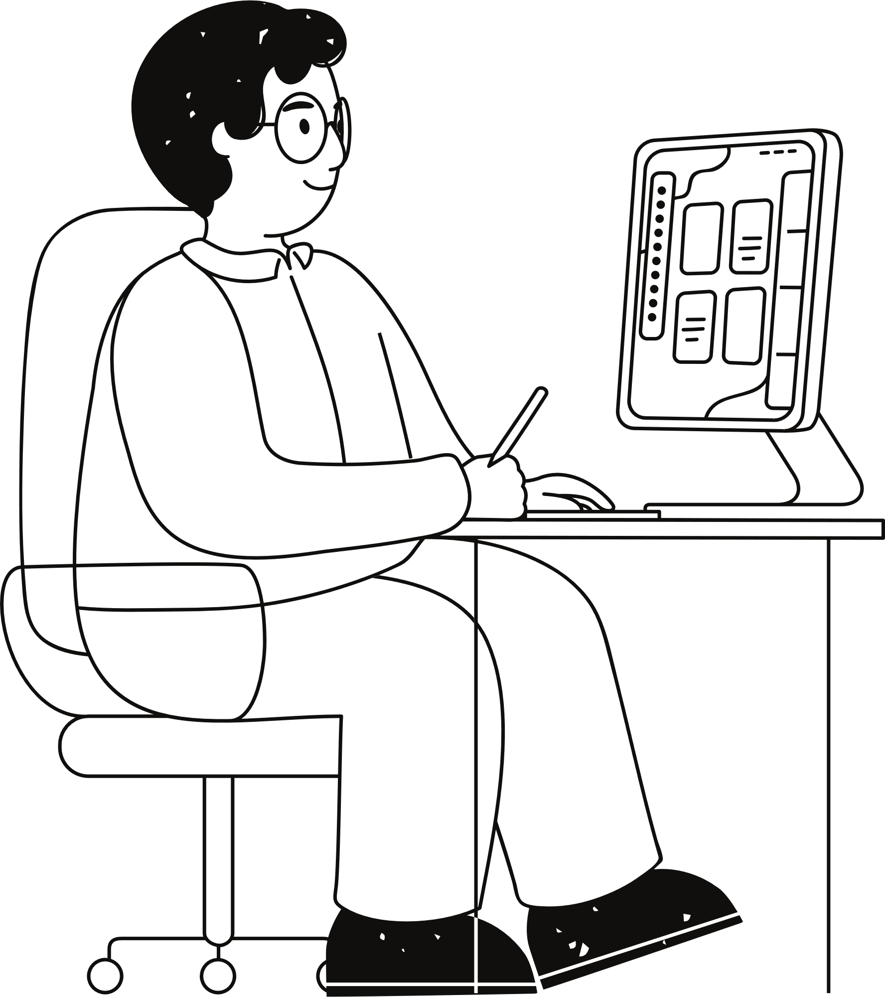
CREATING AN ACCOUNT
THE FIRST STEP TO MY APPLICATION IS THAT USERS NEED TO CREATE AN ACCOUNT FOR THEM TO ACCESS THE VARIOUS DASHBOARDS (UNLESS THEY ARE HR).
users are required to fill in their ROLE (LECTURER OR COORDINATOR), FIRST NAME, LAST NAME, EMAIL,PHONE NUMBER, AND PASSWORD.

Slide 9
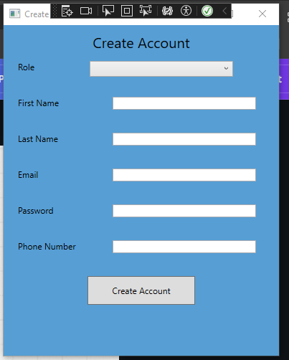
CREATING AN ACCOUNT

Slide 10
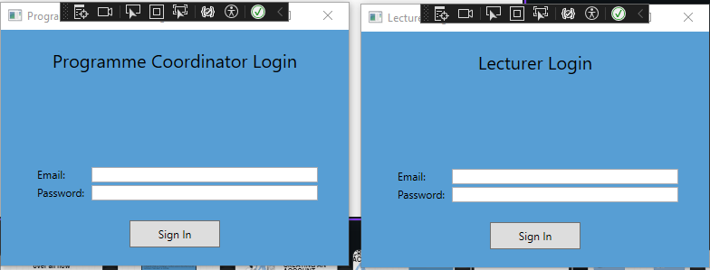
LOGIN
ONCE USERS HAVE CREATED THEIR ACCOUNT THEY MAY LOG IN TO THEIR RESPECTIVE ROLE. THIS LOGIN WILL TAKE THEM TO THEIR DASHBAORD. THE LOGIN SIMPLY PROMPTS USERS FOR THEIR EMAIL AND PASSWORD AND CHECKS THIS AGAINST THEIR ROLE WITHIN THE DATABASE

Slide 11
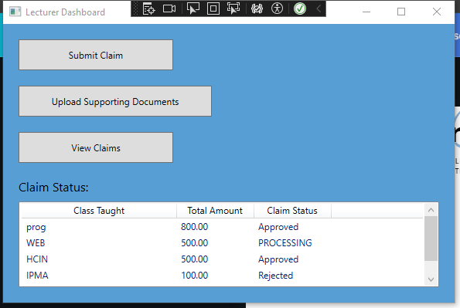
LECTURER DASHBOARD
WHEN A LECTURER LOGS IN THEY ARE TAKEN TO THE LECTUER DASHBOARD WHERE THEY CAN MAKE SUBMISSIONS, VIEW CLAIMS(EDIT OR DELETE) AND UPLOAD SUPPORTING DOCS

Slide 12
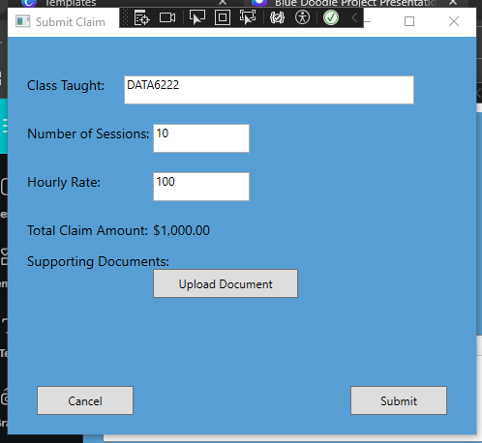
SUBMIT CLAIMS
WHEN LECTURERS SUBMIT CLAIMS THEY NEED TO FILL IN THE MODULE CODE, NO. OF SESSIONS, HOURLY RATE AND A SUPPORTING DOCUMENT, AS PART OF PART 3 A REQUIREMENT IS THAT THEIR IS AN AUTOMATION FEATURE. THE AUTOMATION FEATURE WITHIN THIS AUTOMATICALLY CALLCULATED THE FINAL AMOUNT THAT THE LECTURER SHOULD RECEIVE.

Slide 13
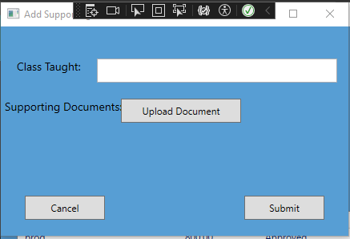
UPLOAD DOCUMENTS
THIS ALLOWS USER TO UPLOAD AN ALTERNATIVE DOCUMENT UNDER THE MODULE THEY TAUGHT

Slide 14
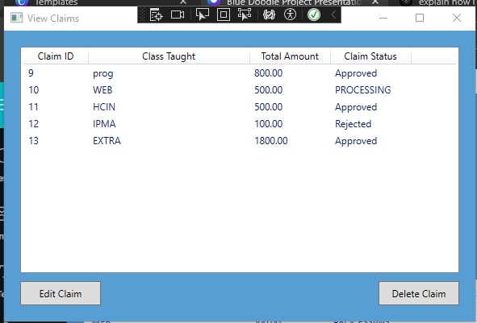
VIEW CLAIMS
THIS ALLOWS USER TO SEE THEIR CLAIM SUBMISSION, THE STATUS THERE OF AND ALLOWS THEM TO EDIT OR DELETE THEIR SUBMISSION.

Slide 15


PROGRAMME COORD DASH
THE PROGRAMME COORDINATOR DASHBOARD ALLOWS COORDINATORS TO CHANGE THE STATUSE OF THE CLAIMS THAT WERE SUBMIT.
AS PART OF THE FINAL POE WE ARE TASKED WITH ADDING AUTOMATION TO IT.
FOR THIS I HAVE ADDED AUTOMATION THAT WILL CHANGE THE STATUS OF CLAIMS SUBMITTED TO APPROVED AUTOMATICALLY IF THEY HAVE 5 OR MORE SESSIONS IN A CLASS AND IF IT IS LESS TO CHANGE THE STATUS TO PENDING.

Slide 16
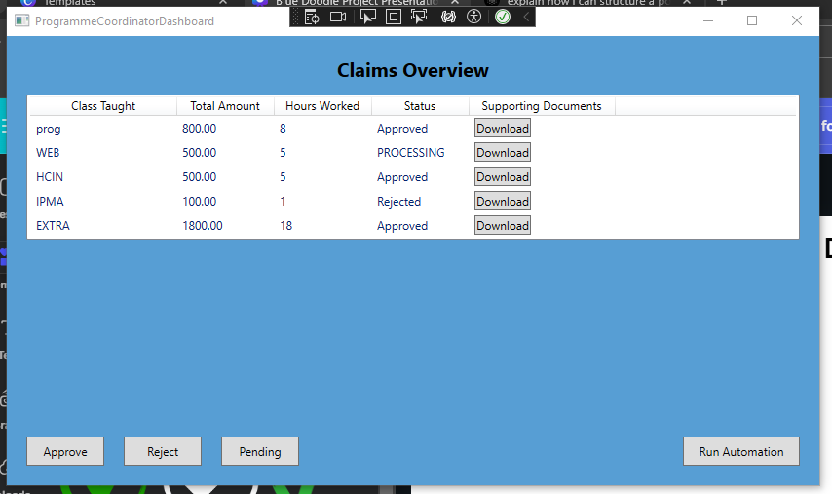
PROGRAMME COORD DASH

Slide 17

NEW FEATURE
HR VIEW IS A NEW FEATURE ADDED TO MY PROGRAM.
HR VIEW WILL AUTOMATICALLY APPROVE OR CHANGE TO PROCESSING OF CLAIMS THAT ARE IN THE “PENDING PHASE”
HR VIEW ALSO WILL GENERATE AN ON SCREEN REPORT OF WHICH CLAIMS ARE APPROVED.
HR VIEW ALSO HAS THE ABILITY TO DELETE CLAIMS.
AND TO UPDATE LECTURER INFORMATION BY SEARCHING FOR THEM.

Slide 18
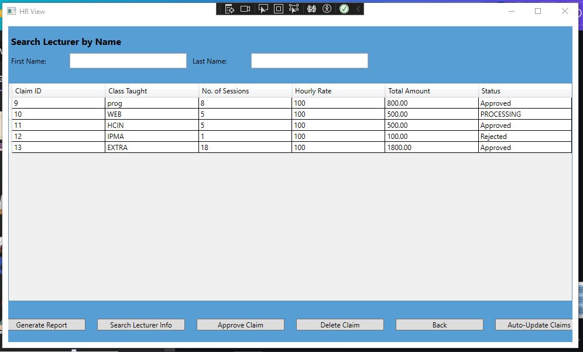
NEW FEATURE ( HR VIEW)

Slide 19
FINAL
SUBMISSION
THESE ARE ALL THE FEATURES I HAVE IMPLEMENTED INTO MY PROGRAM.
I HAVE ENSURED THAT ALL FEATURES ARE EASY TO UNDERSTAND AND THAT IT IS EASILY NAVIGATIONAL FOR ALL USERS. IT ALSO ALLOWS FOR USER ERROR HANDLING MESSAGES TO ENSURE THAT THEY DO NO EXECUTE A FUNCTION INCORRECTLY.

Slide 20

OVERVIEW
IN CONCLUSION MY PROGRAM HAS MEET THE REQUIREMENTS TO ENSURE THAT THE CLAIMS SYSTEM IS EASILY OPERATIONAL FOR USERS AND HAS AUTOMATION FOR THE FINAL SUBMISSION.
FOR A MORE DETAILED SCOPE OF THE OVERALL FUNCTIONS PLEASE CHECK SUBMITTED VIDEO.

Slide 21
Thank you very much!
ST10212542 - AALIYAH ALLIE

